Slide 1
Identifying the optimal location for a distillery in North London
July 2020

Slide 2
Introduction to the problem to be solved: A distillery business is attempting to identify where in North London it should locate a new distillery. The distillery should be located in close proximity to areas where pubs/bars are popular venues, to ensure that there is adequate local demand for the new distillery’s product, and to ensure that it can deliver its product quickly to pubs/bars, as it is demanded.
Objective: To use machine learning to identify the optimal location for a distillery to serve bars and pubs in North London.
Methodology:
To obtain details of North London postal codes, including their latitude and longitude from publicly available data sources.
To use Foursquare’s venue data to identify the most popular categories of venue within a given radius of the postal codes.
To use K-means clustering to identify postal codes where pubs/bars are amongst the most popular categories of venue.
To find the median latitude and longitude of the postal codes contained within the cluster category which encompasses locations where pubs/bars are among the most popular venues. This point will be where the distillery will be located.

Slide 3
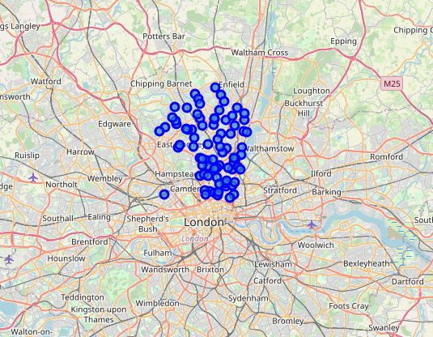
This is a folium plot of the postal codes that will be analysed in this project.
A range of North London postal codes will be analysed to determine in which postal code areas, pubs/bars are amongst the most popular category of venue.
These postal code areas will therefore be classified into two or more clusters. One cluster will represent postal codes where pubs/bars are amongst the most popular category of venue.

Slide 4
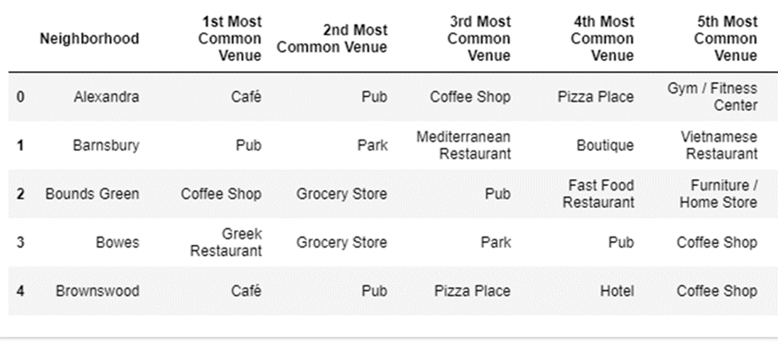
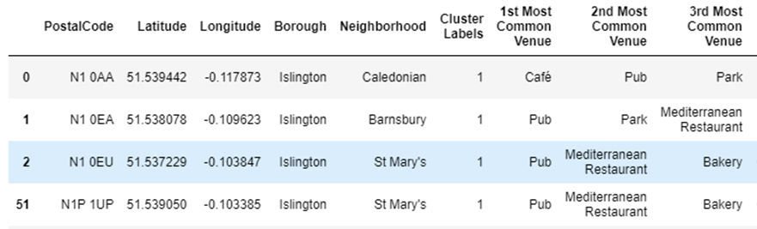
The table below displays the output of the analysis of Foursquare locational data. In particular, for each area, the most popular categories of venue are identified.
The table below displays the output of the K-Means clustering of the geolocational data. Through trial and error it was decided that a two cluster solution was sufficient in order to identify where pubs/bars were amongst the most popular category of venue.

Slide 5
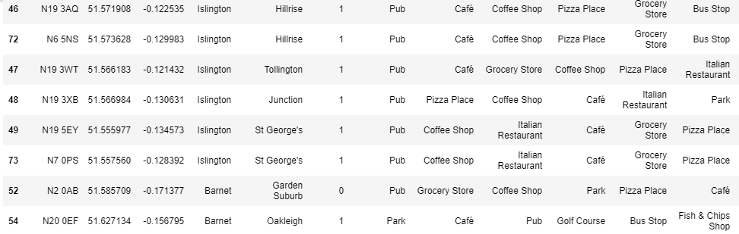
Below is a sample of the cluster 1 postal codes. It is clear that in cluster 1 neighborhoods, pubs are amongst the most popular categories of venue. Note that the clustering is not completely perfect (note the results for 52 and 54 below). It is necessary to examine the cluster 0 results for completeness.

Slide 6
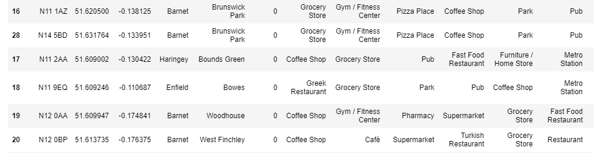
For completeness, the output of a sample of cluster 0 postal codes is set out below. It is clear that in cluster 0 neighborhoods, pubs are not popular venues. Instead grocery stores, gyms, restaurants or coffee shops tend to dominate. This helps to confirm that cluster 1 is the appropriate cluster to use going forwards.

Slide 7
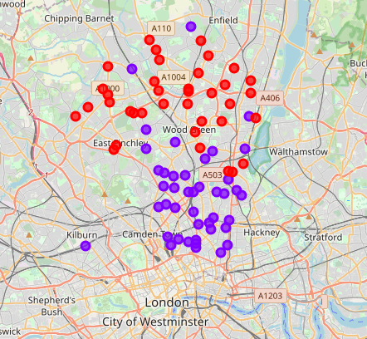
The folium plot on the right hand side demonstrates the postal codes categorised by cluster.
The purple dots represent postal codes which fall within cluster 1 – where pubs are the or one of the most popular category of venue.
The red dots represent postal codes which fall within cluster 0 – where pubs are amongst the least popular category of venue.
Interestingly, cluster 1 postal codes are typically located closer to central London, where people will normally spend their time for recreation e.g. meeting friends.

Slide 8
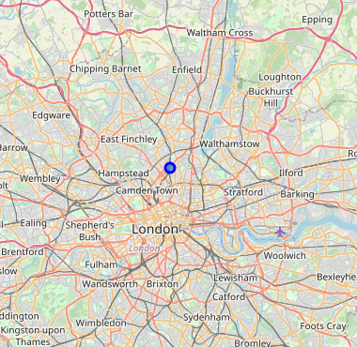
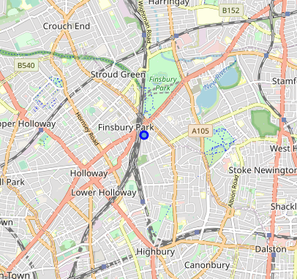
In order to find the optimal location for the distillery, the median latitude and longitude of cluster 1 postal codes was determined. The result has been plotted below – with one map including a close up of the area. Therefore, the optimal location for the distillery, to ensure that it is in close proximity to areas where pubs are prevalent, is the Finsbury Park area of North London.

Slide 9
Conclusions:
We have successfully identified, through the use of geolocational data and K-Means Clustering, the optimal location for a distillery in North London.
Based on the analysis, Finsbury Park is the optimal location for the distillery.
Locating the distillery in Finsbury Park will help to ensure that the distillery is located in close proximity to areas where pubs are the most or one of the most popular categories of venue – i.e. there are numerous buyers for the distillery’s products.
Further work that could be performed:
An additional analysis which would help to validate that Finsbury Park is the optimal location for the distillery, would be to use Foursquare’s geo-locational data in order to identify trending venues, for example, on a Friday or Saturday evening. The analysis performed in this project could be re-run in order to classify postal codes based on trending venues instead of where pubs are amongst the most popular category of venue. This would help to confirm that the pubs in the cluster 1 neighbourhoods (where pubs are common) are in fact popular with visitors. There is a possibility that whilst this analysis has identified areas where pubs are common, without performing an additional analysis of trending venues, there is a risk that the distillery is located in the centre of postal codes which have a large number of pubs which aren’t popular with visitors and therefore are just surviving.

